Slide 1
RESPONDING TO THE ABORTION CONSULTATION
#giveachildachance

Slide 2
WHAT HAS HAPPENED?
The law on abortion in Northern Ireland changed dramatically on 22 October 2019.
Much of the old law was repealed leaving no protection for unborn children until they are capable of being born alive.
#giveachildachance

Slide 3
WHAT THE NEW LAW SAYS
The Northern Ireland (Executive Formation) Act 2019 requires the Secretary of State to legislate for abortion in the following cases:
Threat to the pregnant woman’s physical or mental health, without conditionality of “long-term or permanent” effects;
Rape and incest;
Severe fetal impairment, including fatal fetal abnormality, without perpetuating stereotypes towards persons with disabilities and ensuring appropriate and ongoing support, social and financial, for women who decide to carry such pregnancies to term.
#giveachildachance

Slide 4
OVERVIEW
Proposals include: -
‘unrestricted access’ to abortion up to 12/14 weeks.
Abortion on un-defined and loose ‘health’ grounds up to 22/24 weeks.
Abortion up to birth where the baby is not likely to survive birth or much beyond.
Abortion up to birth for disability including assessment based on ‘quality of life’.
Abortion up to birth where risk to life greater than terminations and risk of ‘grave permanent injury’ to health.
One ‘healthcare professional’ to sign off.
Flexible location.
Data collection.
Limited conscientious objection protection.
Exclusion zones for those protesting or offering alternative help.
#giveachildachance

Slide 5
OVERVIEW
We have identified two key areas to mitigate the impact of this legislation:-
93.3% of abortions in GB happen within the first 14 weeks.
98% of abortions in GB are on the grounds on mental health.
Therefore, we are proposing the lowest possible gestational limits and the highest possible bar on health.
#giveachildachance

Slide 6
0
12-14
22-24
Birth
NIO – UNRESTRICTED ACCESS
We’re responding:
No unrestricted access
Reduced gestational limit
Meaningful link to health
NIO – FOR UNDEFINED HEALTH REASONS
We’re responding:
Reduced gestational limit
Meaningful link to health
NIO – FOR DISABILITY OR ‘GRAVE PERMANENT INJURY TO PHYSICAL OR MENTAL HEALTH’
We’re responding:
Remove quality of life test
Link to assembly working group report
Argue it’s discriminatory
#giveachildachance

Slide 7
HOW TO RESPOND
You should have the online consultation survey open in front of you or a hard copy of the questions and a pen.
You should have sight of a copy of the consultation guidance which will help you through how to respond to each question.
It’s really important to use your own words and say how this consultation could personally affect you or your family.
#giveachildachance

Slide 8
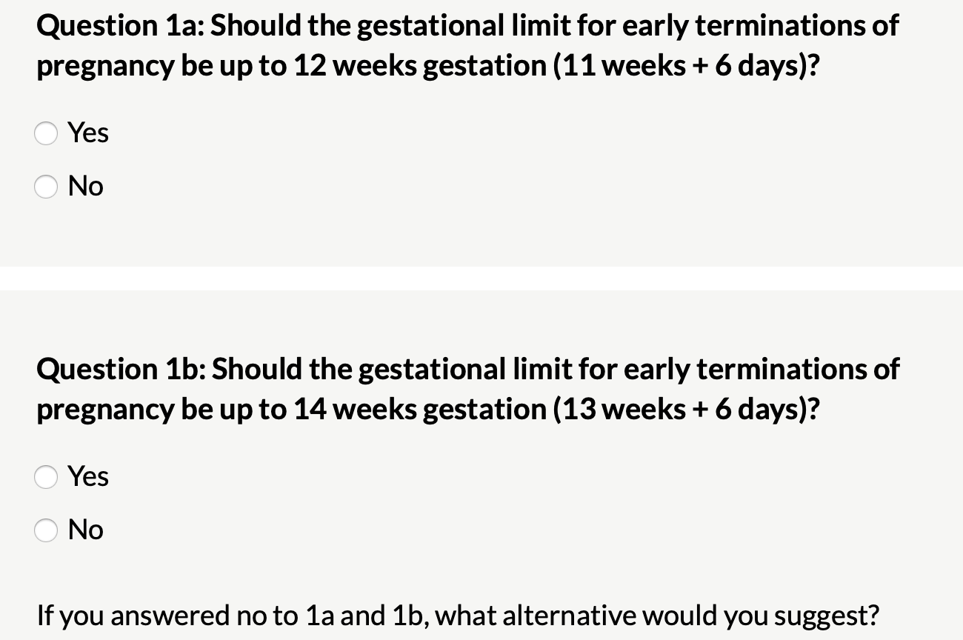
#giveachildachance

Slide 9
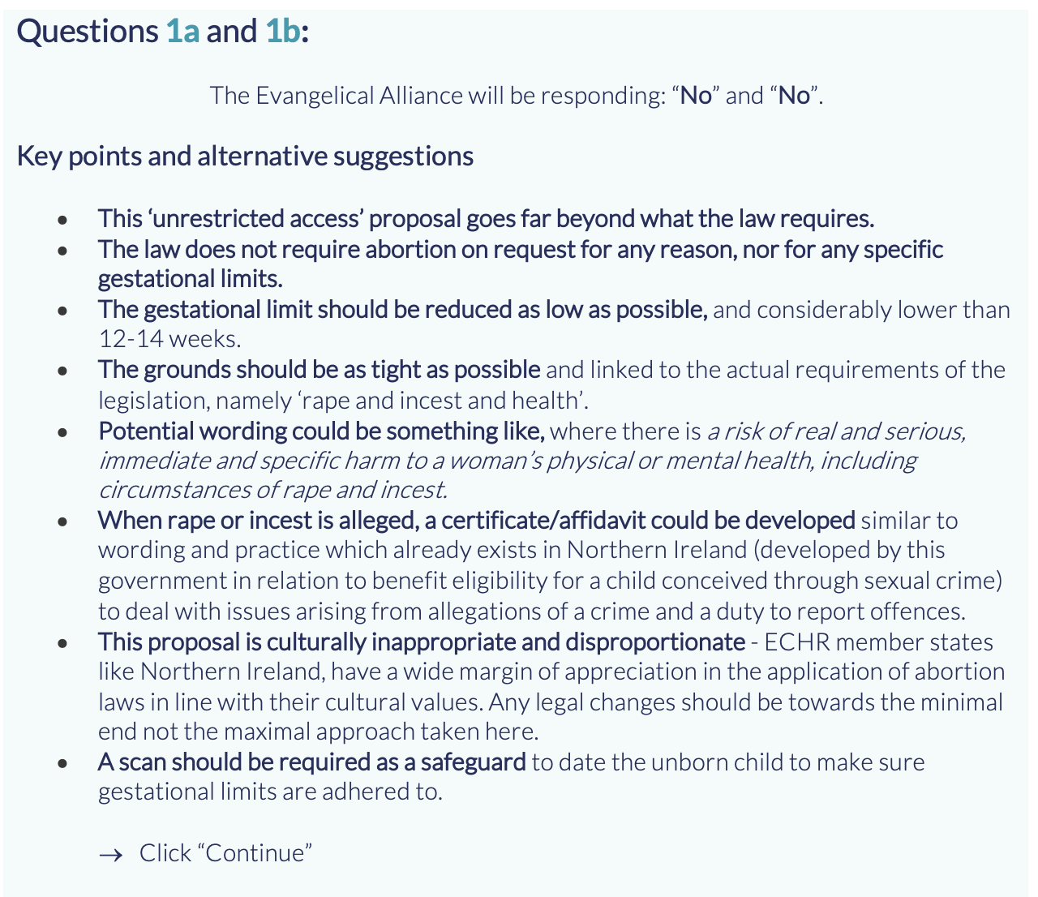
#giveachildachance

Slide 10
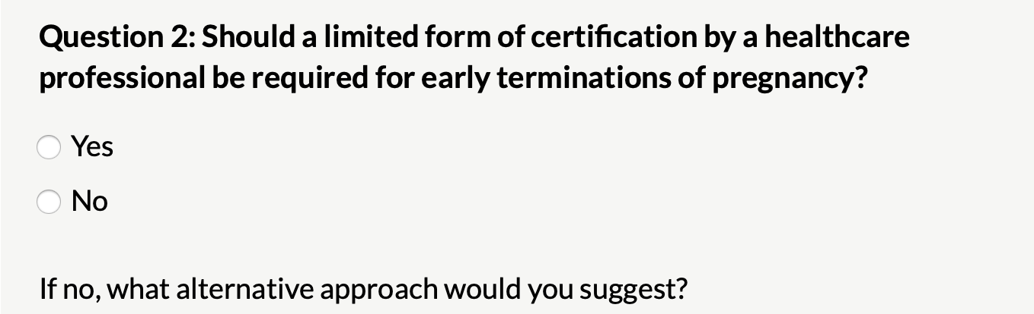
#giveachildachance

Slide 11
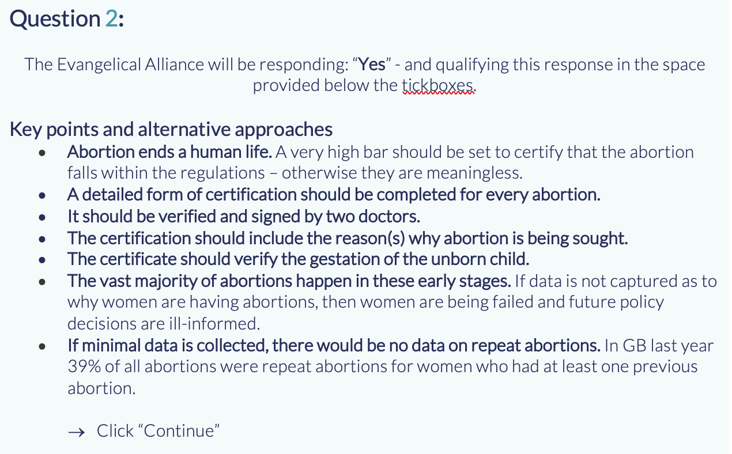
#giveachildachance

Slide 12
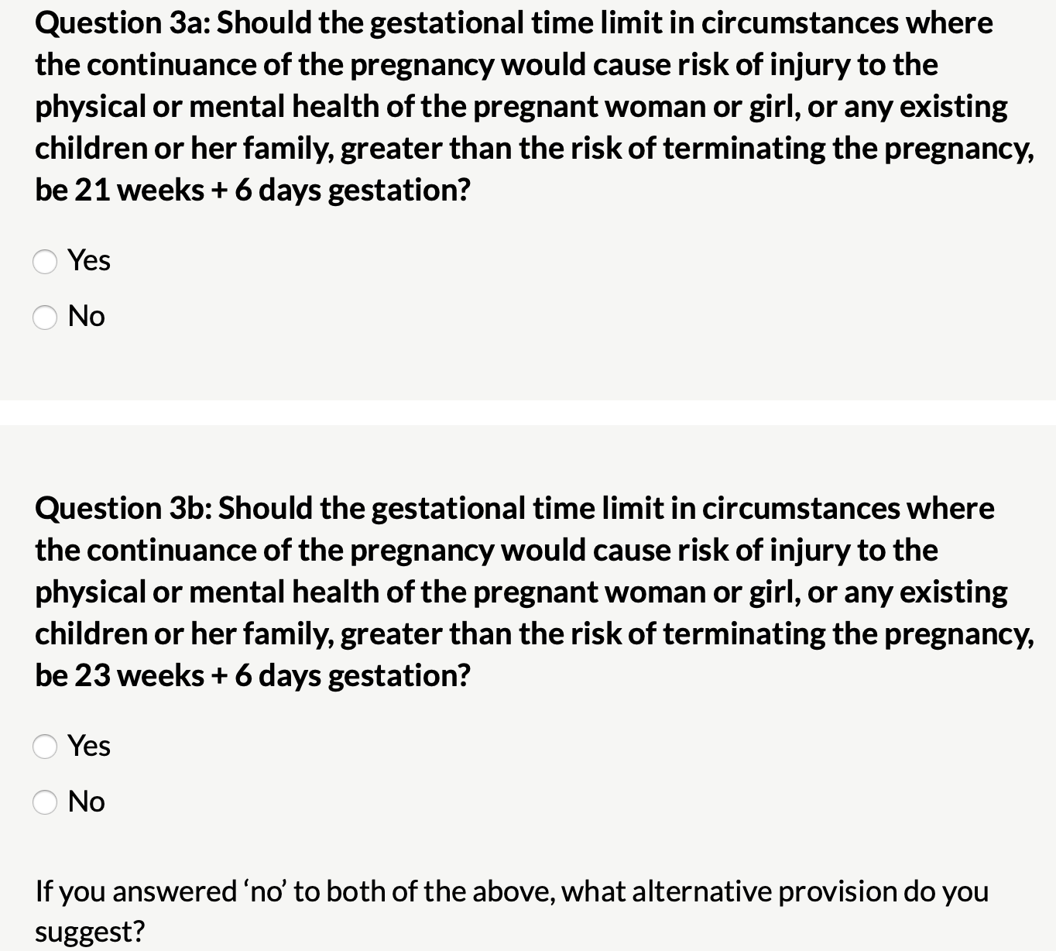
#giveachildachance

Slide 13
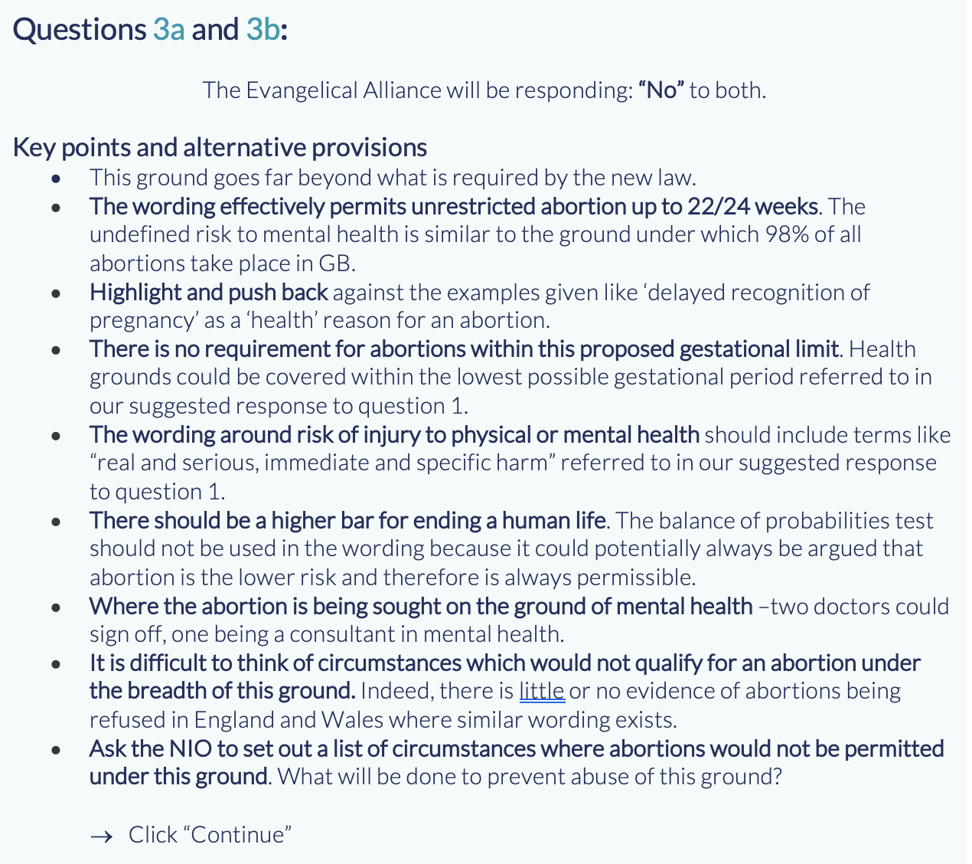
#giveachildachance

Slide 14
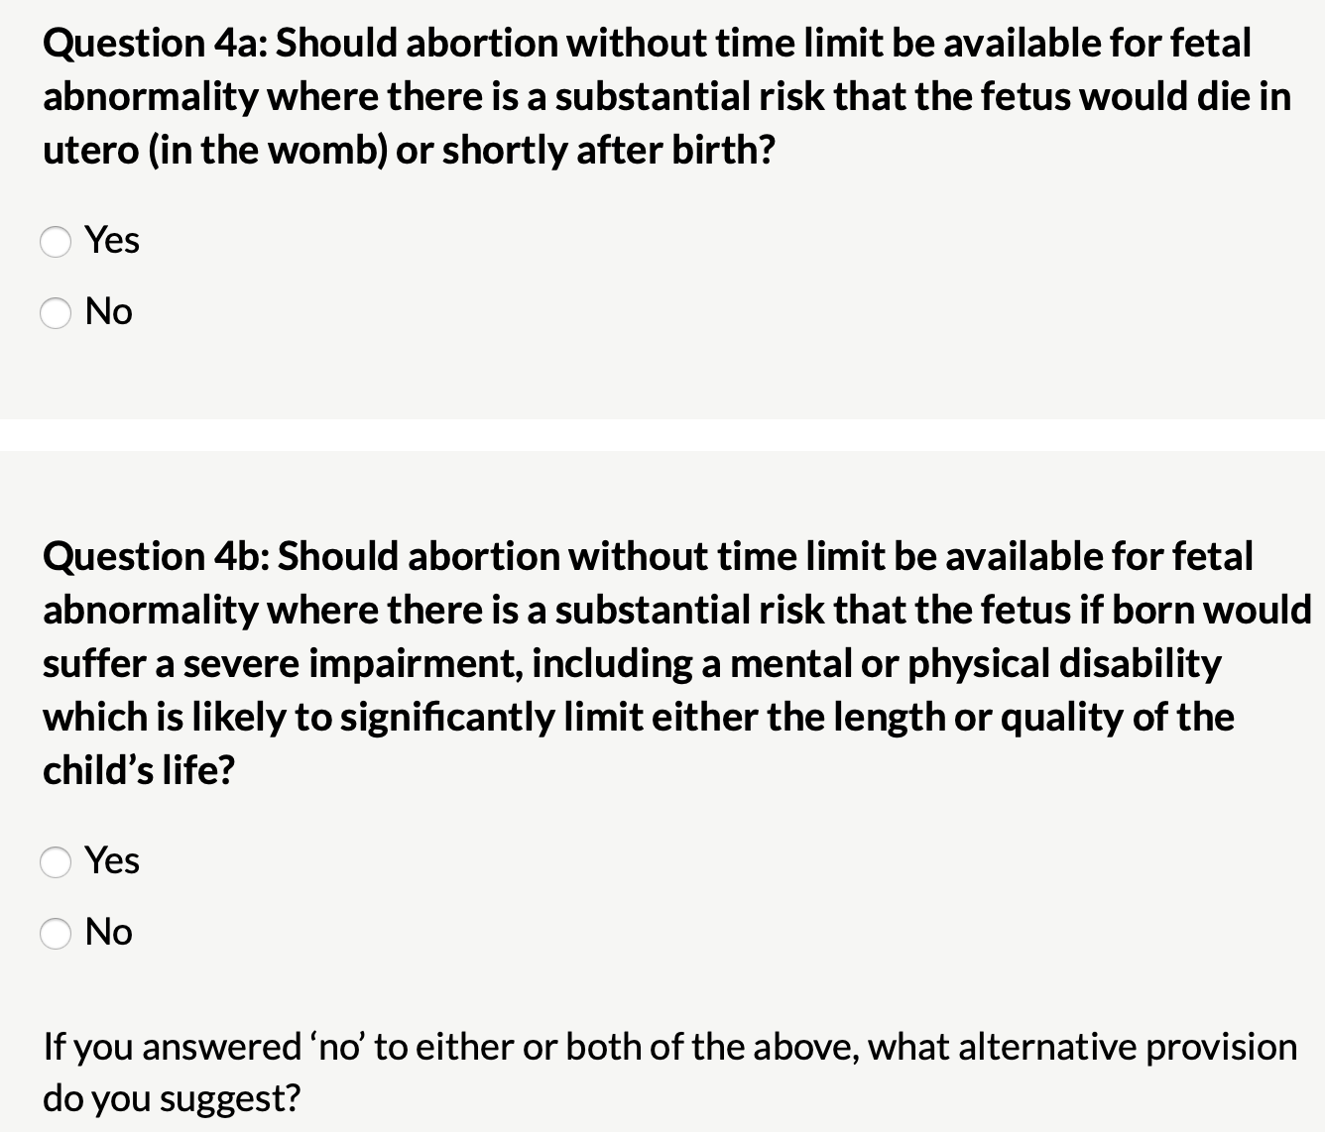
#giveachildachance

Slide 15
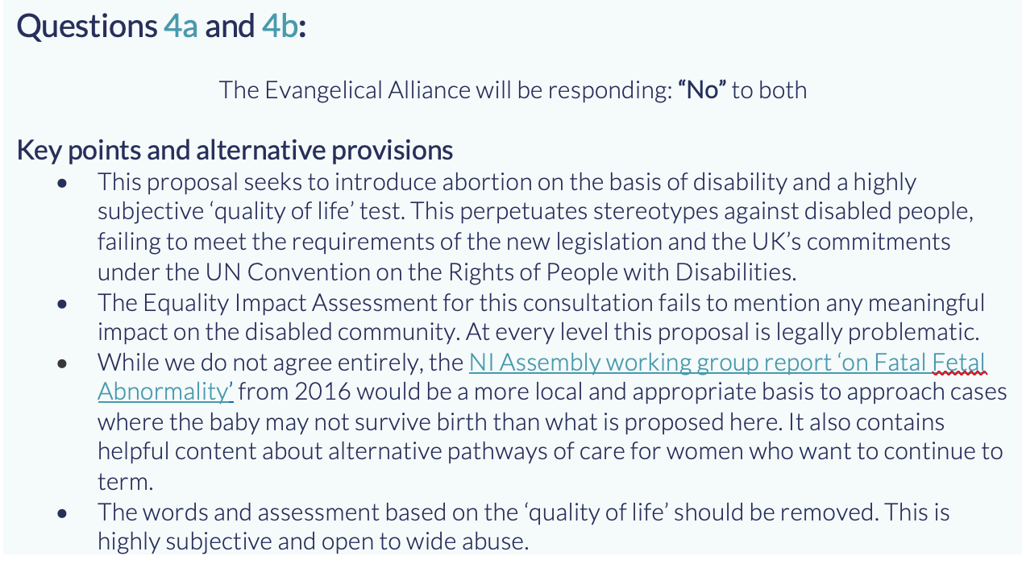
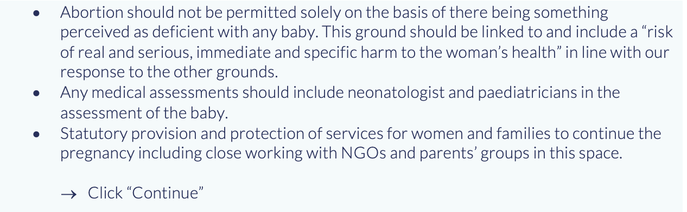
#giveachildachance

Slide 16
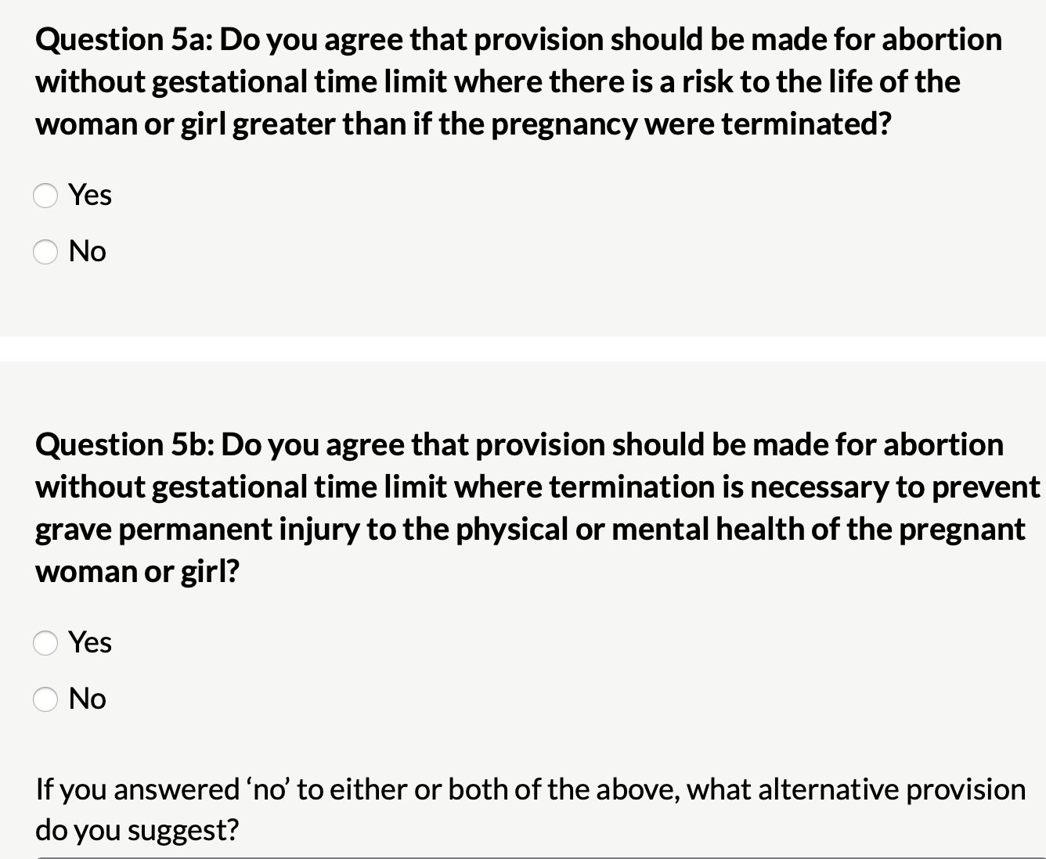
#giveachildachance

Slide 17
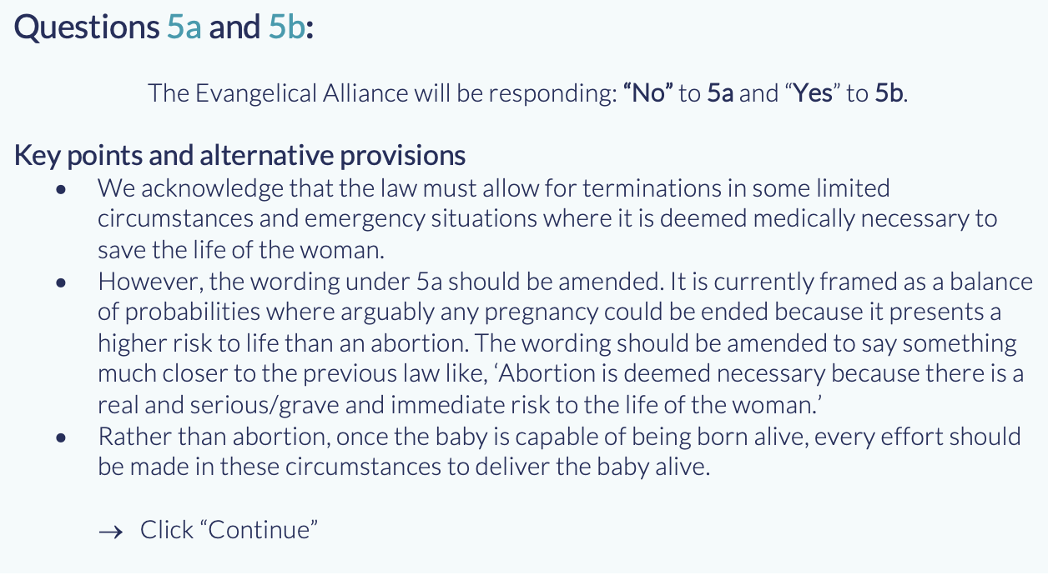
#giveachildachance

Slide 18
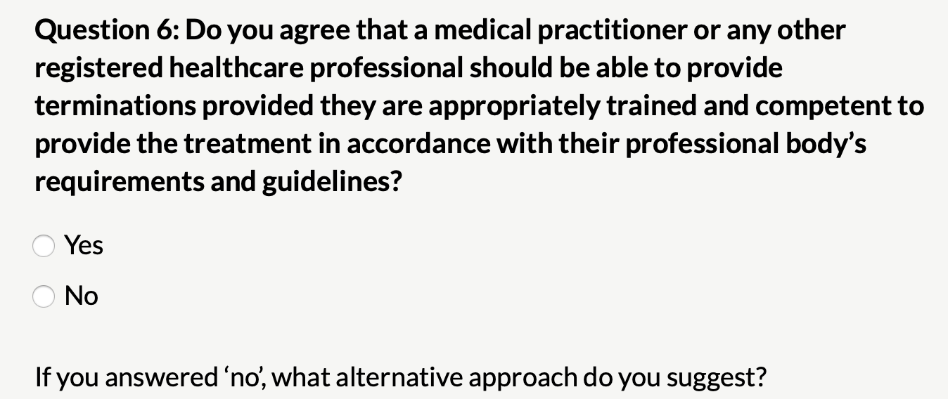
#giveachildachance

Slide 19
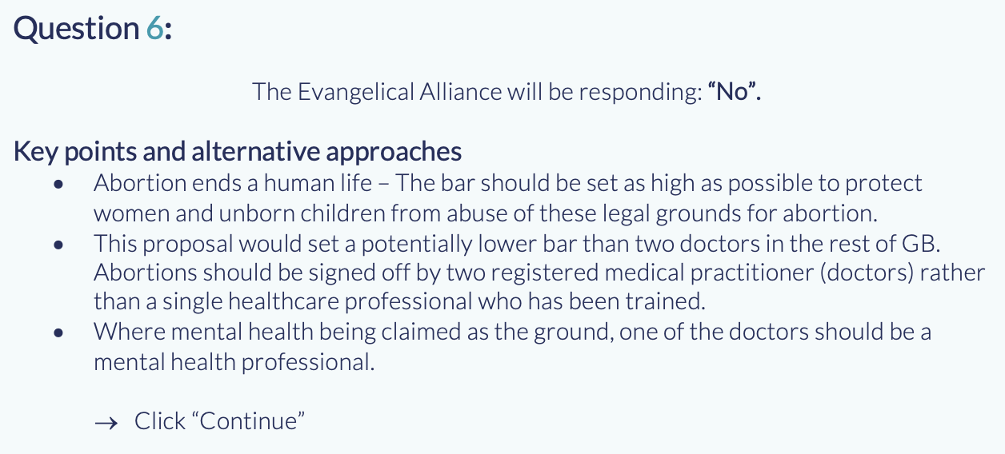
#giveachildachance

Slide 20
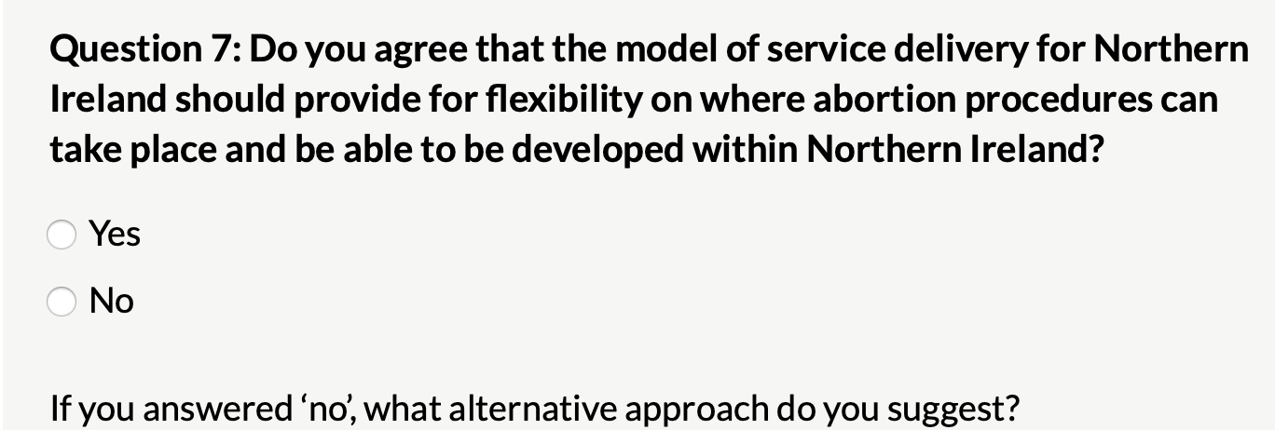
#giveachildachance

Slide 21
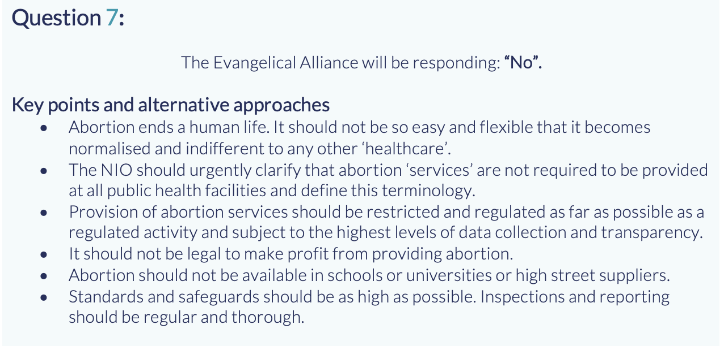
#giveachildachance

Slide 22
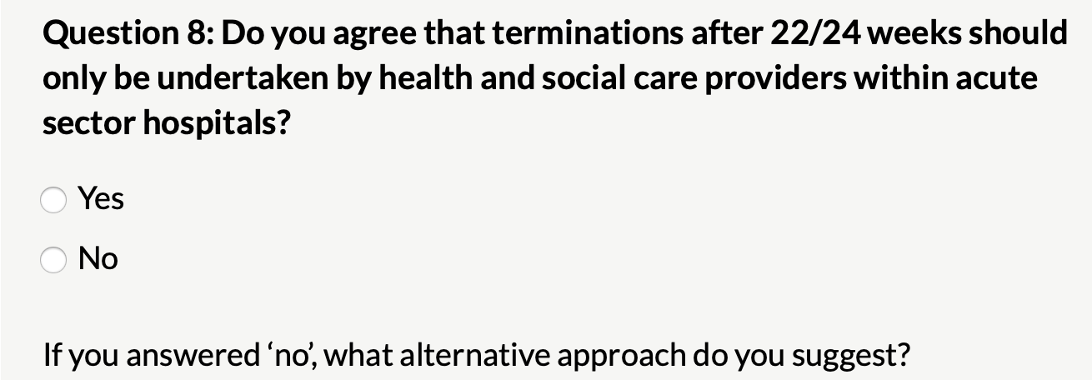
#giveachildachance

Slide 23
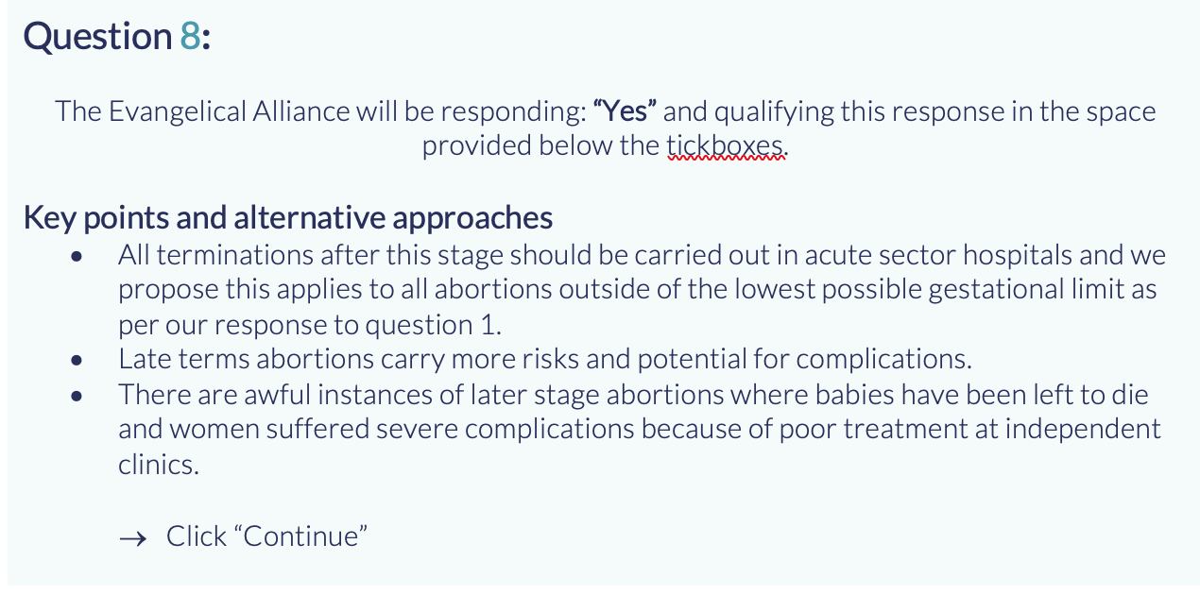
#giveachildachance

Slide 24
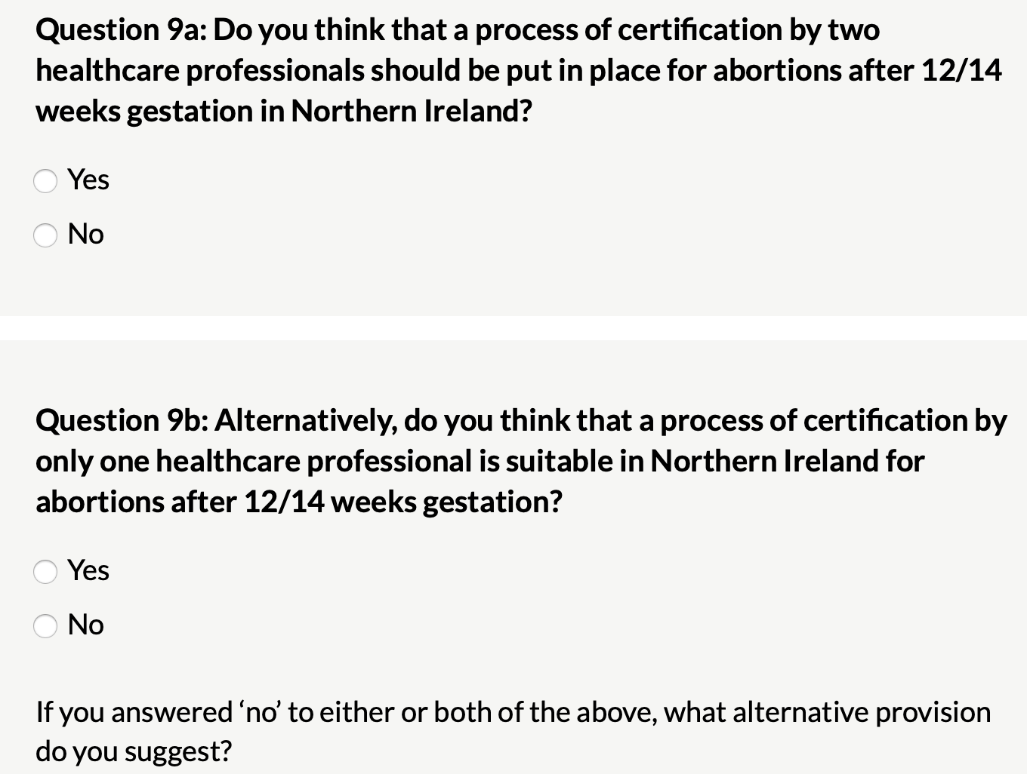
#giveachildachance

Slide 25
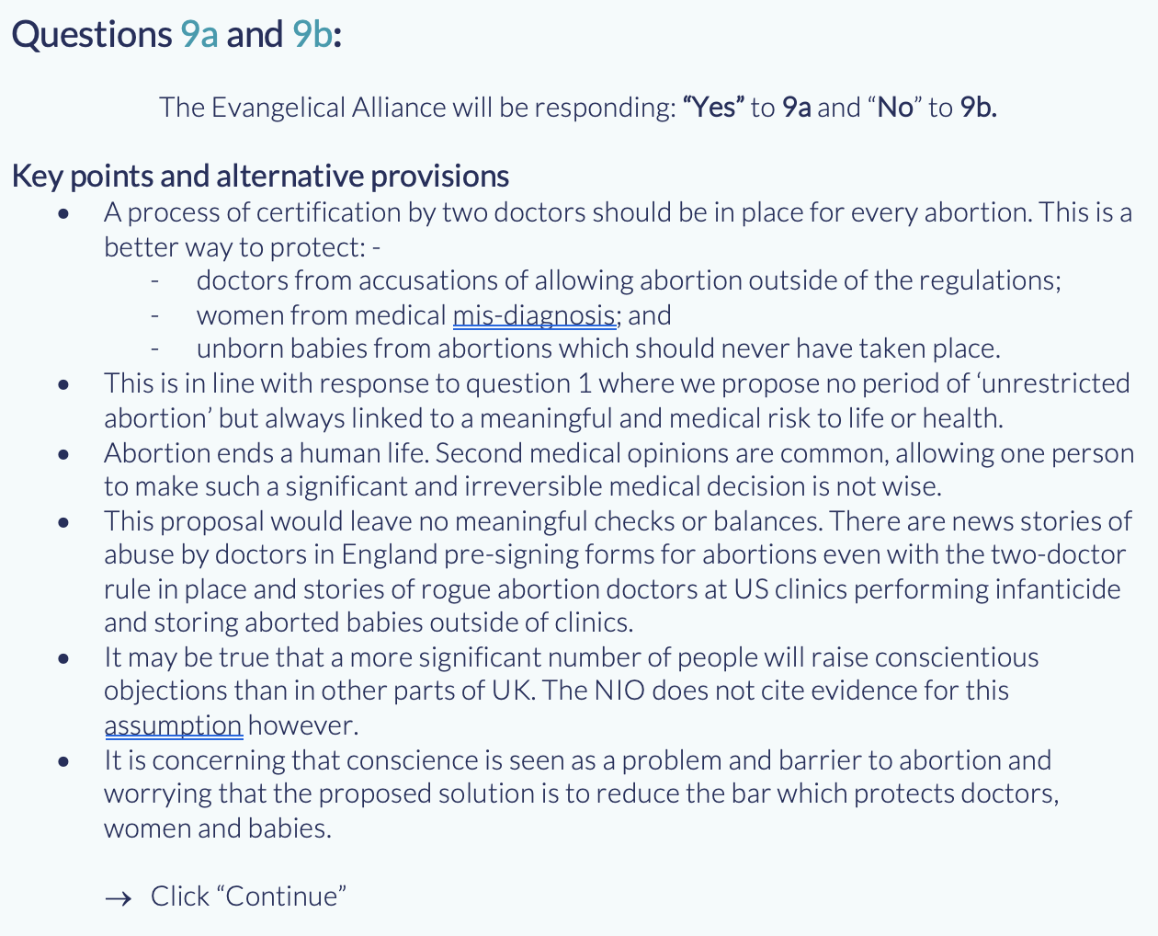
#giveachildachance

Slide 26
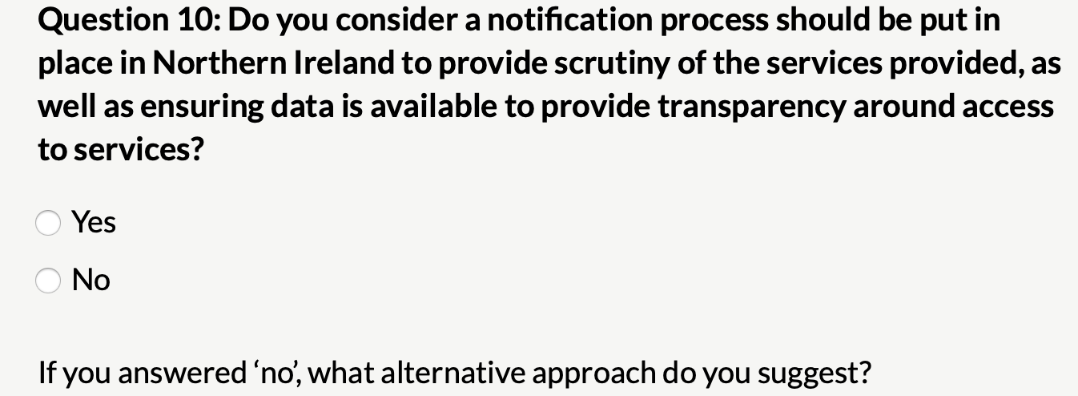
#giveachildachance

Slide 27
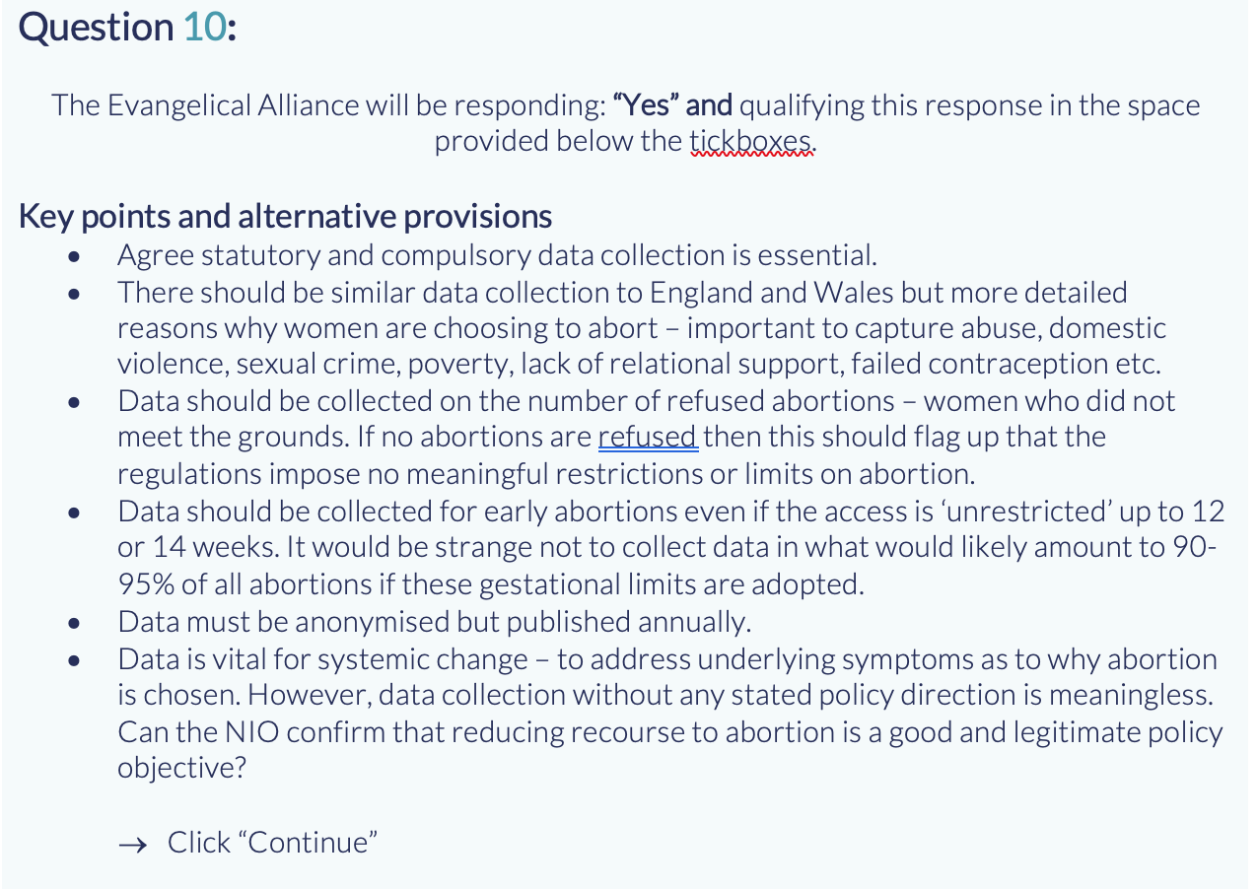
#giveachildachance

Slide 28
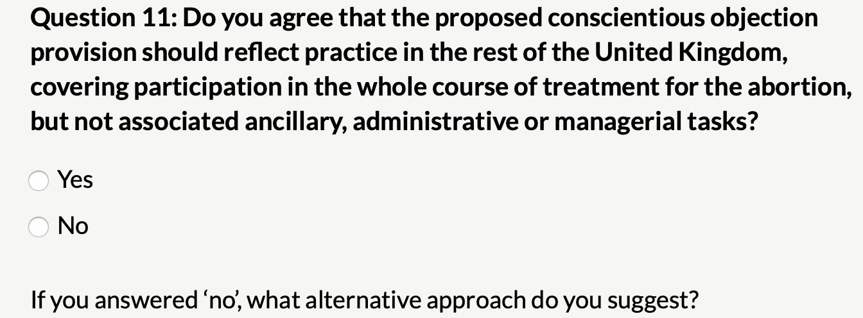
#giveachildachance

Slide 29
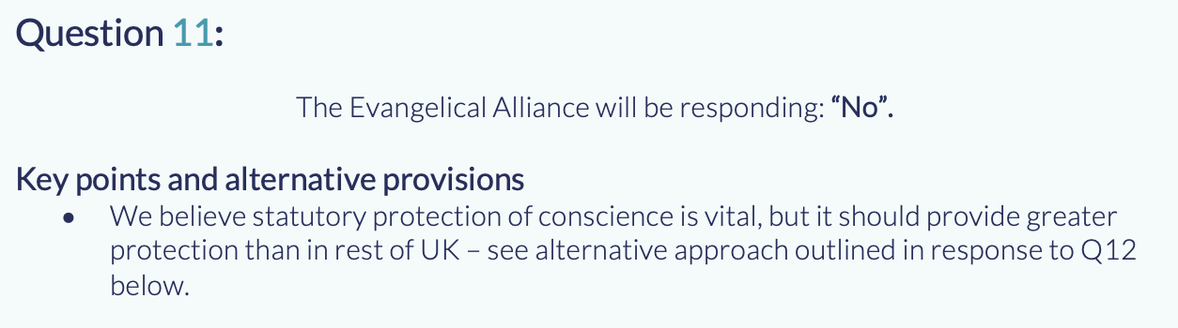
#giveachildachance

Slide 30
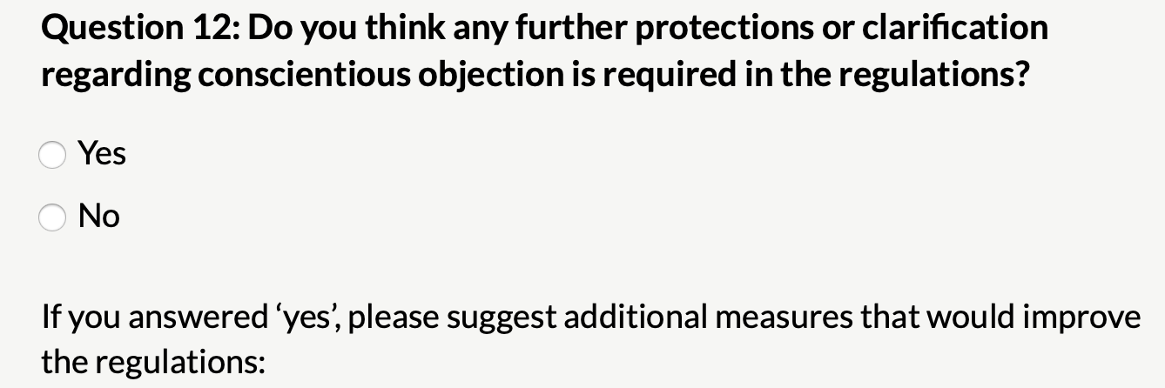
#giveachildachance

Slide 31
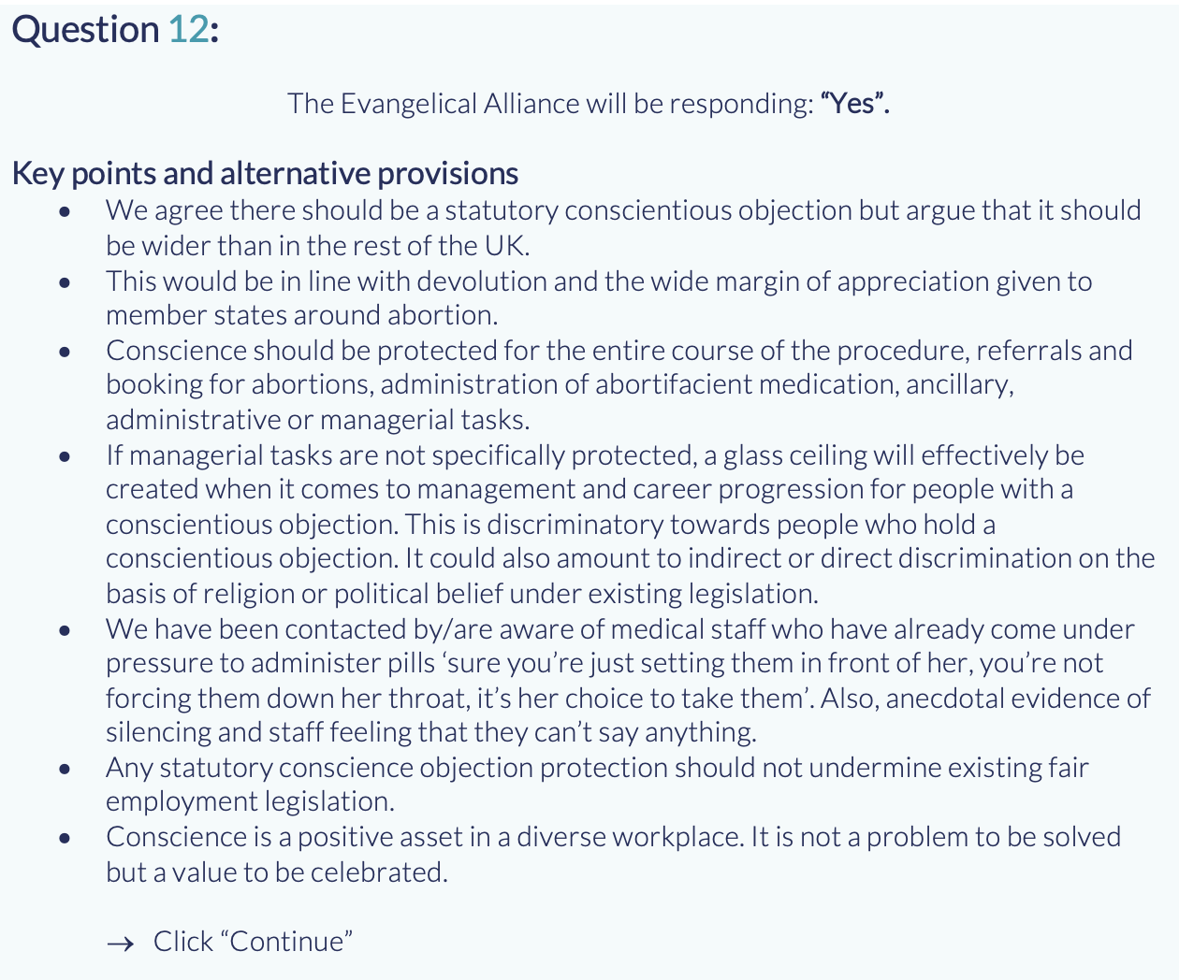
#giveachildachance

Slide 32
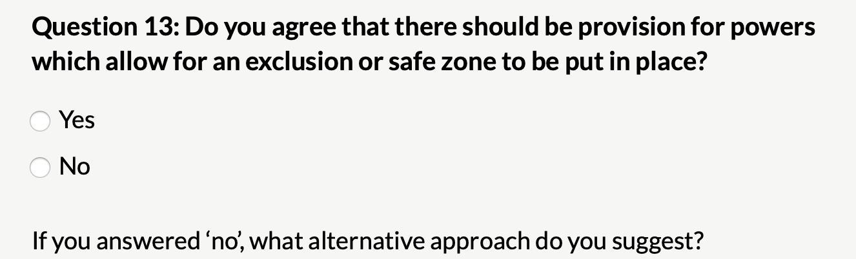
#giveachildachance

Slide 33
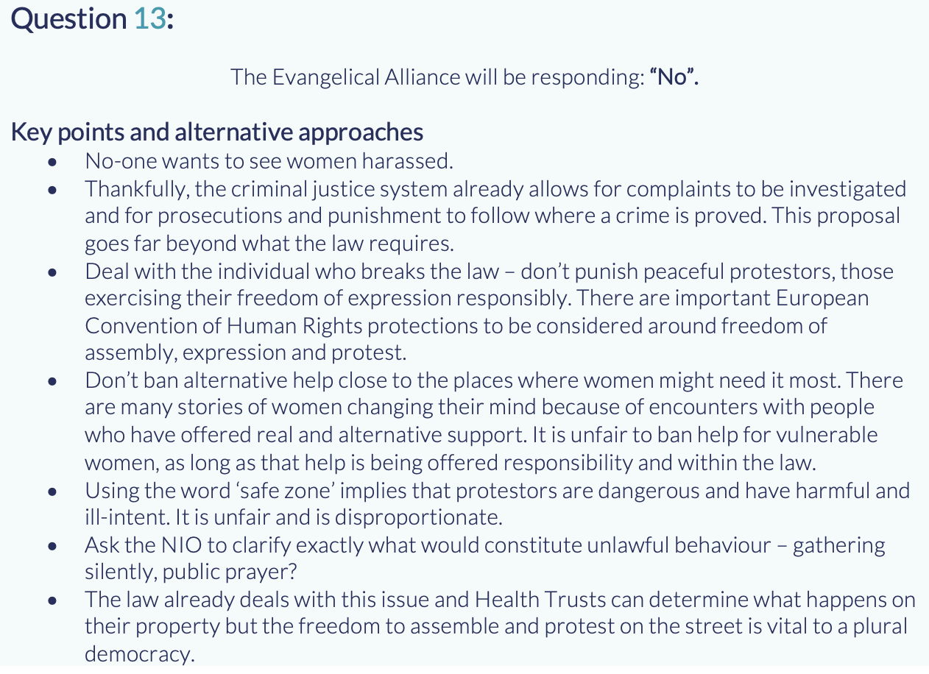
#giveachildachance

Slide 34
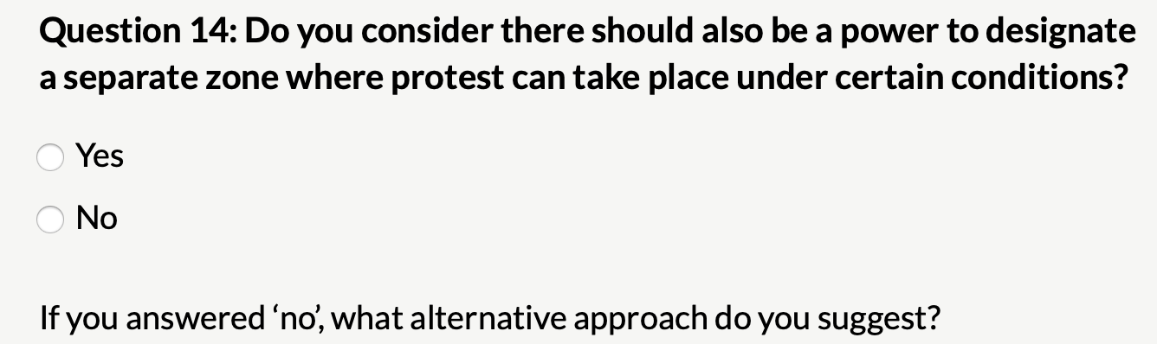
#giveachildachance

Slide 35
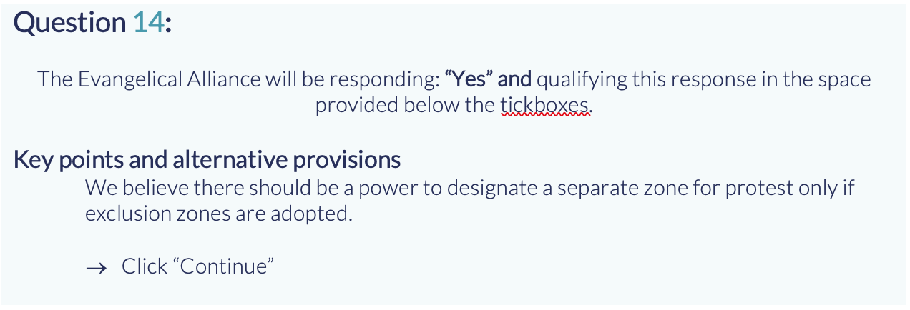
#giveachildachance

Slide 36
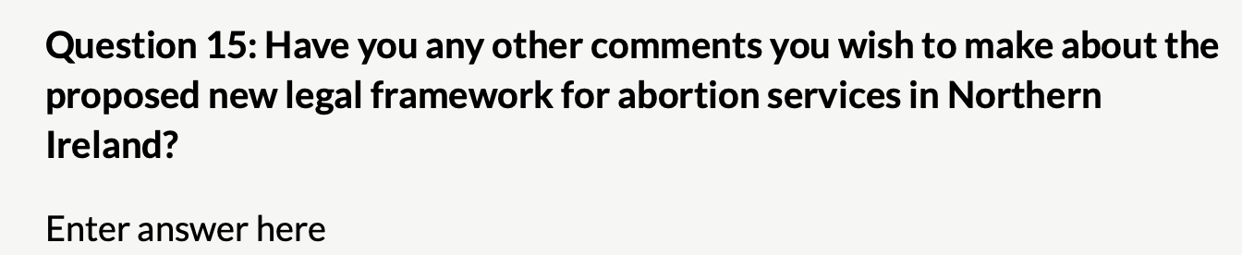
#giveachildachance

Slide 37
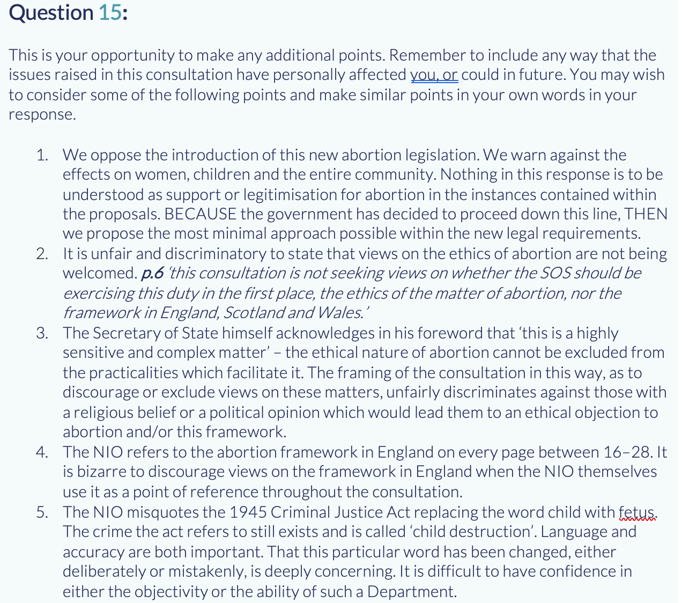
#giveachildachance

Slide 38
You’re almost done!
Now don’t forget to submit your response online or send your response in the post.
Thank you.

